Slide 1

NI
Lecture
Networking Infrastructure
IP Subnetting
6
Networking Infrastructure
Diploma in CSF / IT
Year 2 (2022/23), Semester 3
Notes:
Left-hand Bar – Replace FSP by your module code and X by the lecture number.
Replace Lecture Title
Replace < Module Name >
Replace Year and Semester if necessary

Slide 2
Main Topics
IP Addressing (IPv4)‏
Public and Private IP Addresses
Subnetting
Classless Inter-Domain Routing (CIDR)
Fixed Length Subnet Mask (FLSM)
Variable Length Subnet Mask (VLSM) (Optional)

Slide 3
IP Addresses (Recap)
The Internet Corporation of Assigned Names and Numbers (ICANN), a private, non government organization, issues all IP addresses.
IP addressing (IPv4) uses a 32-bit Address field; the bits in the Address field are numbered 0 to 31.
IP addresses take the form of four numeric fields separated by periods.
Mechanisms to overcome the limitations in IP address space
Private IP address
Subnet addressing
Classless addressing known as CIDR
Notes:
3

Slide 4
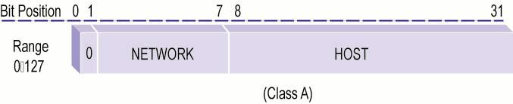
Class A Address (Recap)
A Class A network address has the leading bit set to 0, a 7-bit network number, and a 24-bit local host address.
The first octet ranges from 0–127, although 0 and 127 are reserved and cannot be assigned to networks and hosts, as shown on the Class A Network Address Diagram.
Class A Network Address
Notes:
4

Slide 5
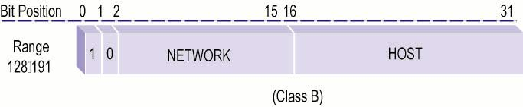
Class B Address (Recap)
A Class B network address has the two highest-order bits set to 1-0, a 14-bit network number, and a 16-bit local host address.
The first octet ranges from 128–191, as shown on the Class B Network Address Diagram.
Class B Network Address
Notes:
5

Slide 6
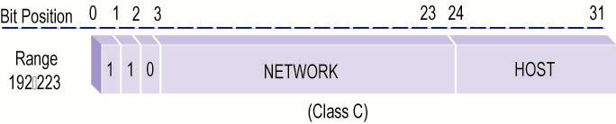
Class C Address (Recap)
A Class C network address has the three leading bits set to 1-1-0, a 21-bit network number, and an 8-bit local host address.
The first octet ranges from 192–223, as shown on the Class C Network Address Diagram.
Class C Network Address
Notes:
6

Slide 7
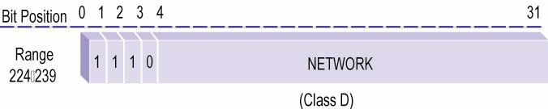
Class D Address (Optional)
The four highest order bits are set to 1-1-1-0, and the remaining 28 bits specify a multicast group ID.
The first octet ranges from 224–239. This concept is illustrated on the Class D Network Address Diagram.
Class D Network Address
Notes:
7

Slide 8
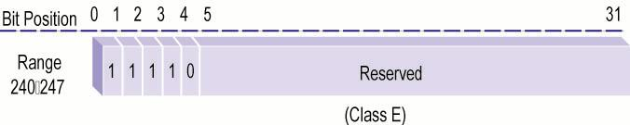
Class E Address (Optional)
The five highest order bits are set to 1-1-1-1-0, and the first octet ranges from 240–247, as illustrated on the Class E Network Address Diagram.
Class E Network Address
Notes:
8

Slide 9
Addressing Rules (Recap)
The following rules pertain to assigning IP addresses:
Bits that define the host portion of an IP address should not be all 1 bits. (broadcast addresses)
Bits used to define the host portion of an IP address should not be all 0 bits. (network ID)
Class A network number 127 is assigned the loopback function.
ICANN has designated certain address ranges as private or reserved addresses.
Notes:
9

Slide 10
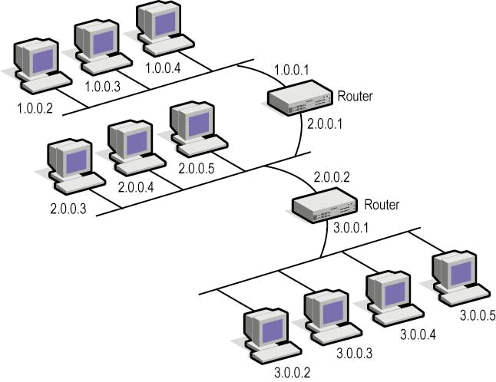
Sample Network Using Class A Address (Recap)
Note an IP address has two components: network ID and host ID components.
Segments connected by switches share the same network ID fields, while having different host fields.
Segments interconnected by routers must have different network ID fields, as illustrated on the “Sample Class A Network” Diagram.
Sample Class A Network
Notes:
10

Slide 11
Public and Private IP addresses (Recap)
Internet Assigned Numbers Authority (IANA) manages the supply of IP addresses to ensure no duplication of publicly used addresses.
All public IP addresses must be obtained from an Internet Service Provider or a registry at some expense.
Private IP addresses are used within networks (e.g. intranet, test lab, home network, etc) that are not connected to the Internet.
Internet router discard packets with private IP addresses.
Note: NAT (network address translation) can be used to translate private IP addresses to public IP addresses to allow internet sharing.‏
IP Address Class
RFC 1918 Internal Address Range
Class A
10.0.0.0 – 10.255.255.255
Class B
172.16.0.0 – 172.31.255.255
Class C
192.168.0.0 – 192.168.255.255
Notes:
11
Internet routers immediately discard private addresses.

Slide 12
IP Broadcast Addresses
There are two IP broadcast address types:
Limited broadcast
A packet sent to IP address 255.255.255.255 is classified as a “limited broadcast” packet.
Limited broadcast passes through a switch but blocked by a router.
Directed broadcast
A packet sent to a destination IP address where only the host portion of the IP address is all 1s is classified as a “directed broadcast” packet e.g. 192.168.1.255
Directed broadcasts may pass through a router and reach all hosts on the target network.
Notes:
12
A network-directed broadcast address the host portion of the IP address as all ones and a valid network portion. The broadcast reaches all hosts on the network.
For subnet-directed broadcast has the host portion of the IP address as all ones, a valid network portion, and a valid subnet portion. The broadcast reaches all hosts on the subnet.

Slide 13
Default Subnet Mask (Recap)
A subnet mask is a 32-bit binary number network device used to separate an IP address’s network portion from its host portion.
Each IP address class is assigned a default subnet mask:
Class
Decimal
Binary
A
B
C
255.0.0.0
255.255.0.0
255.255.255.0
11111111.00000000.00000000.00000000
11111111.11111111.00000000.00000000
11111111.11111111.11111111.00000000
Notes:
13

Slide 14
Subnetting
Reasons for Subnetting
Improve network performance and reduce network congestion (without subnetting, a broadcast will reach every device in the network)
Better network security (without subnetting, if a device gets compromised, the entire network become visible)
Prevent wastage of IP address**
Based on the structure of an organization, the network administrator determines the number of subnets needed and number of hosts on each subnet.
A network device e.g. router will use the subnet mask to determine the destination subnet network ID by performing an AND operation with Destination IP address of the incoming packet.
Notes:
https://www.cbtnuggets.com/blog/cbt-nuggets/five-reasons-to-subnet
https://www.networkcomputing.com/data-centers/5-subnetting-benefits

Slide 15
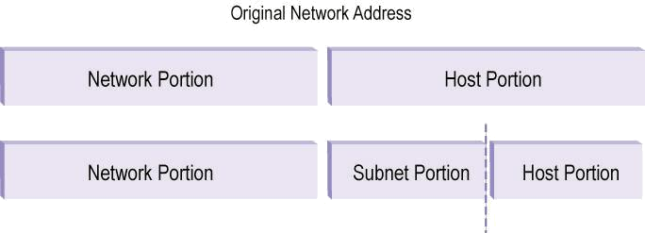
Creating Subnets
We use the subnet mask to determine which bits of the host portion define the subnet portion i.e. borrow host bits to become subnet bits
This subnet portion then becomes part of the IP address’s network portion.
The number of host bits to be borrowed depends on the number of subnets to be created.
Notes:
15

Slide 16
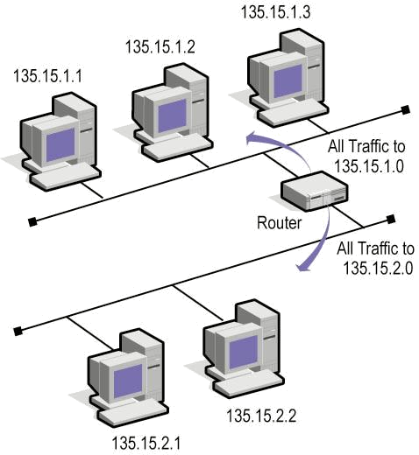
Example of Subnetting
In the Subnet Addressing Diagram, the network’s administrator has created two subnets from a single Class B network address, 135.15.0.0, using the network address’s third octet (135.15.x.0).
Subnet Addressing
Notes:
16
Subnet mask is 255.255.255.0 (borrow 8 bits) instead of the Class B default 255.255.0.0

Slide 17
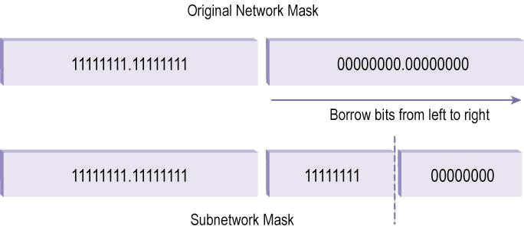
Creating Subnets
We must always borrow host bits in descending order, starting from the left most bit position (MSB) and working to the right (LSB), as shown in the Borrowed (Lending) Bits Diagram.
Borrowed (Lending) Bits
Notes:
17

Slide 18
Maximum Usable Subnets and Hosts
Subnetting provides us a great deal of flexibility in determining the number of subnets we can create and the number of hosts we can support on each subnet.
These numbers vary by the network address Class, as the Subnet and Hosts Table lists.
Address Class
Maximum Number of Hosts
Maximum Number of Subnets
A
B
C
16.777.214
65,534
254
4,194,302
16,382
62
Notes:
18

Slide 19
Establishing the Subnet Information
Subnet masks give the router the information required to compute which subnet a particular host resides on.
Number of borrowed bits depends on :
number of subnets required and
maximum number of hosts per subnet
Formula to find the no. of host bits to borrow to become subnet bits is:
No of required subnets <=2 ^{subnet bits} - 2
Note that “-2” part is because two subnets are not used. RFC950 (a standard) requires that subnet number zero and all-ones subnet be restricted.
First subnet obtained after subnetting the network address is called subnet zero. A subnet zero address has all subnet bits set to binary 0s.
Last subnet obtained is called the all-ones subnet. An all-ones subnet address has all the subnet bits set to binary 1s.

Slide 20
Establishing the Subnet Information
However, today the use of subnet zero and subnet all ones are allowed and are generally accepted.
If subnet zero and all-ones subnet are allowed, then the following formula is used instead:
No of required subnets ≤2 ^{subnet bits}
Formula to find the no of usable hosts per subnet is:
Usable hosts per subnet = 2^{h} – 2
where h = the remaining host bits
“-2” is to account for the 2 reserved addresses (the network address and broadcast address) that cannot be assigned to any hosts.

Slide 21
Class C IP addressing (N.N.N.H) Subnetting
Given a Class C network address 195.63.10.0, how to create 10 subnets ?
Network
Host
Borrow from Host bits
IP Address
195
63
10
0
nnnnhhhh
Network
Host
Default Subnet Mask
11110000
255
255
255
0
Using formula: usable subnets = 2^{lending bits} – 2 ≥ 10
Assume subnet-zero and all-ones subnet are not used.
To satisfy condition 2^{lending bits} – 2 ≥ 10 => lending bits must be 4.
Determine new subnet mask:
11110000 = 128 + 64 + 32+ 16 = 240
255.255.255.240
No of. usable host => 2⁽⁸⁻⁴⁾ – 2 = 14 hosts per subnet

Slide 22
Class C IP addressing (N.N.N.H) Subnetting
Find the IP address ranges for the subnets : (Assumed first subnet & last subnet are not used)
Network
Subnet
Hosts (Add. range)‏
Comment
195.63.10.
s s s s
h h h h
128 64 32 16
8 4 2 1
0 0 0 0
-
Not used
First useable subnet
(195.63.10.16)‏
0 0 0 1
0 0 0 1
to
1 1 1 0
IP address range: 195.63.10.17 to .30
Second useable subnet
(195.63.10.32)‏
0 0 1 0
0 0 0 1
to
1 1 1 0
IP address range: 195.63.10.33 to .46
Third useable subnet
(195.63.10.48)‏
0 0 1 1
0 0 0 1
to
1 1 1 0
IP address range: 195.63.10.49 to .62
…………
…………..
………….
…………
Last useable subnet
(195.63.10.224)‏
1 1 1 0
0 0 0 1
to
1 1 1 0
IP address range: 195.63.10.225 to .238
1 1 1 1
Not used

Slide 23
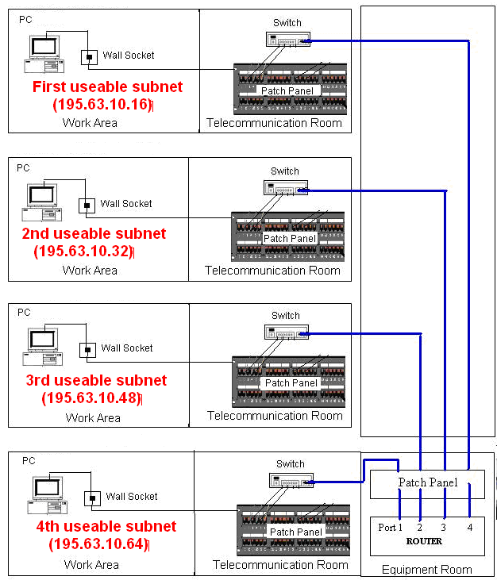
IP Implementation
Next step after determining the IP address range is to implement the subnet.
Note that a router interconnects each subnet. All the devices in each subnet are assigned the range of IP addresses in that subnet.
Notes:
Note: Backbone patch panels in the TRs are not shown.

Slide 24
IP Prefixes
We can represent the subnet mask in another manner, as a prefix rather than a mask.
The prefix represents number of network / subnet bits.
Rather than writing out the subnet mask, for instance, 255.255.255.240, we can represent the same mask as “/28.”
Example: 206.13.1.48/25
“/25” indicates the first 25 bits are used to identify unique network remaining 7 bits to identify the specific hosts.
Notes:
24

Slide 25
Activity
The school ABC has been assigned a class C network address 218.1.1.0 by an Internet Service Provider. You are to subnet the proposed network into 3 subnets. Assume each floor is allocated one subnet.
Your subnetted IP addressing scheme should include the following:
new subnet mask
number of hosts per subnet
subnet address for each subnet
IP address ranges for the first three subnets

Slide 26
Problem with Class-Based Addressing
Class based address allocation does not match real needs:
Class A: too few to give out.
Class C : one address block too small for most sites.
Class B: What everyone wants but running out.
Classful system of allocating IP addresses is wasteful
anyone who need slightly more than 254 host addresses given a class B address block of 65534 host addresses.
Notes:
https://www.practicalnetworking.net/stand-alone/classful-cidr-flsm-vlsm/

Slide 27
What is CIDR?
Classless Inter-Domain Routing (Pronounced as cider)
Also known as classless or prefix based addressing.
Explained in RFC 1517 - 1520.
A method that eliminates the traditional concept of Class A, Class B and C network addresses and that enables efficient allocation of IP address space as it assign address space based on needs.
Developed to overcome the exhaustion of class B address space and the explosion of routing between tons of class C addresses.
Allow companies to be allocated exact number of networks they need.

Slide 28
CIDR Address Notation
Whole concept of IP address classes is done away with entirely
The whole unicast range (any IP address with a first octet of 0 – 223) can be allocated in any size block
CIDR Notation:
Specifies the mask associated with an address by appending a “prefix”.
Instead of being limited to "prefixes" of /8, /16 or /24, CIDR uses varying network prefixes anywhere from 13 to 30 bits.
ClDR represents network numbers in terms of a base network number and mask of contiguous bits.
Example: CIDR Address -192.168.190.0/18
“18” says that the first 18 bits are the network part of the address, leaving 14 bits for specific host addresses.
“192.168.190.0” is the network address itself and is also known as base address.

Slide 29
Please view these Powerpoint slides using presentation mode – points in some slides are in sequences.
Notes:
Fixed Length Subnet Mask (FLSM) requires all subnet masks to be the same for all subnets.
Classful, CIDR, FLSM, VLSM: https://www.practicalnetworking.net/stand-alone/classful-cidr-flsm-vlsm/

Slide 30
FLSM Subnetting Example (1)
Given this network: 192.168.1.0
To design subnet IDs for the network
How many subnets are there?
Assume: The use of subnet zero and subnet all ones are allowed.

Slide 31
FLSM Subnetting Example (2)
Net A supports 24 hosts,
Nets C and G each supports 14 hosts, Net E supports 6 nodes
Nets B, D and F each only has 2 hosts.
Assume: The use of subnet zero and subnet all ones are allowed.
Net A (24)
Net C
(14)
Net B
(2)
Net D (2)
Net F
(2)
Net G
(14)
Net E
(6)
.

Slide 32
FLSM Subnetting Example (3)
Given network 192.168.1.0
Derive the subnets
Number of subnet bits:
7 <= 2 ^{bits}
No. of subnet bits = 3
Subnet mask:
255.255.255.224
Assign subnet ID to each
of the 7 subnets.
No. of hosts in each subnet
is 2⁵ – 2 = 30.
Assume: The use of subnet zero and subnet all ones are allowed.

Slide 33
FLSM Subnetting Example (4)
Network ID: 192.168.1.0
Subnet mask: 255.255.255.224
Assign subnet ID to each of the 7 subnets:
192.168.1.64
192.168.1.0
192.168.1.32
192.168.1.96
Assume: The use of subnet zero and subnet all ones are allowed.
192.168.1.160
192.168.1.192
192.168.1.128

Slide 34
FLSM Subnetting Example (5)
3 bits are “borrowed” from host portion for subnet ID.
5 bits left in the host portion
Hence each subnet can have 2⁵ – 2 = 30 hosts.
Net A (24)
Net C
(14)
Net B
(2)
Net D (2)
Net F
(2)
Net G
(14)
Net E
(6)
Subnets B, D, F and E are under-utilized.

Slide 35
Subnet usage
Notes:
IPv4 Subnet Calculator: https://www.site24x7.com/tools/ipv4-subnetcalculator.html

Slide 36
Variable Length Subnet Mask (VLSM)
Using VLSM, the subnets in a same IP network may have different subnet masks, depending on the number of hosts in each subnet.
This gives rise to efficient allocation of IP addresses.
Notes:
VLSM (hidden slides) – further reading for interested students.

Slide 37
What We Have Covered
IP Addressing (IPv4)‏
Public and Private IP Addresses
Subnetting
CIDR
FLSM
VLSM (Optional)

Slide 38
Thank You
Questions ?

Slide 39
Optional
Example on
VLSM

Slide 40
VLSM (1)
Start from the subnet with the largest number of hosts.
Net A - 24 hosts require 5 host bits [ 24 =< 2⁵-2 ]
Left with 3 bits for subnet representation (borrow 3 bits)
Hence subnet mask is 255.255.255.224 or /27 mask
Net A subnet ID is 192.168.1.0/27, host addr range: 1 to 30
Net A (24)
Net C
(14)
Subnet 0
Net B
192.168.1.0/27
Hosts address range
from 1 to 30
Net D
Net F
0 0 0 0 0 0 0 1 to
0 0 0 1 1 1 1 0
Net E
(6)
Net G
(14)

Slide 41
VLSM (2)
Next subnet with the largest number of hosts – Net C
14 hosts require 4 host bits [ 14 =< 2⁴-2 ]
Left with 4 bits for subnet representation (borrow 4 bits)
Hence subnet mask is 255.255.255.240 or /28 mask
Net C subnet ID is 192.168.1.32/28,
host addr range: 33 to 46 (Net A uses 1 to 30)
Net A (24)
Net C
(14)
192.168.1.32/28
Hosts address range
from 33 to 46
Net B
0 0 1 0 0 0 0 1 to
0 0 1 0 1 1 1 0
192.168.1.0/27
Hosts address range
from 1 to 30
Net D
Net F
Net E
(6)
Net G
(14)

Slide 42
VLSM (3)
Similarly, Net G with 14 hosts require 4 host bits.
Need to borrow 4 bits for subnet representation.
Hence subnet mask is also 255.255.255.240 or /28 mask
Net G subnet ID is 192.168.1.48/28, host addr range: 49 to 62 (Net C uses 33 to 46)
192.168.1.32/28
Hosts address range
from 33 to 46
Net A (24)
Net C
(14)
192.168.1.48/28
Hosts address range
from 49 to 62
Net B
Net D
Net F
Net E
(6)
Net G
(14)

Slide 43
VLSM (4)
Net E with 6 hosts require 3 host bits.
Need to borrow 5 bits for subnet representation.
Hence subnet mask is also 255.255.255.248 or /29 mask
Net E subnet ID is 192.168.1.64/29, host addr range: 65 to 70 (Net C uses 49 to 62)
Net A (24)
Net C
(14)
192.168.1.48/28
Hosts address range
from 49 to 62
Net B
Net D
192.168.1.64/29
Hosts address range
from 65 to 70
Net F
Net E
(6)
Net G
(14)

Slide 44
VLSM (5)
Net B with 2 hosts require 2 host bits.
Need to borrow 6 bits for subnet representation.
Hence subnet mask is also 255.255.255.252 or /30 mask
Net E subnet ID is 192.168.1.72/29, host addr range: 73 to 74 (Net C uses 65 to 70)
Net A (24)
Net C
(14)
Net B
192.168.1.72/30
Hosts address range
from 73 to 74
Net D
Net F
192.168.1.64/29
Hosts address range
from 65 to 70
Net E
(6)
Net G
(14)

Slide 45
VLSM (6)
Similarly, both Net D & F have 2 hosts require 2 host bits.
Need to borrow 6 bits for subnet representation.
Hence subnet mask is also 255.255.255.252 or /30 mask
Net D subnet ID is 192.168.1.76/30, host addr : 77 to 78
Net F subnet ID is 192.168.1.80/30, host addr : 81 to 82
Net A (24)
Net C
(14)
192.168.1.80/30
Hosts address range
from 81 to 82
Net B
192.168.1.76/30
Hosts address range
from 77 to 78
Net D
Net F
Net E
(6)
Net G
(14)

Slide 46
Subnet usage - VLSM
100%
100%
100%
100%
100%
100%
Free to use

Slide 47
Tools to use for VLSM
VLSM Chart
VLSM Calculator

